Slide 1
Topic Models for Bleacher Report Basketball Articles
Stephen Albro and Cyrille Combettes

Slide 2
Agenda
Project Motivation and Goal
2. Data Collection and Cleaning
3. Topic Modeling with LDA
4. Visualizations
Notes:
Today we will walk through the motivation for our project, including what we see as its ultimate goal. Then we will talk about the data gathering and cleaning process. Then we will deep dive into our topic modeling work, and finish with some visualizations of our results.

Slide 3
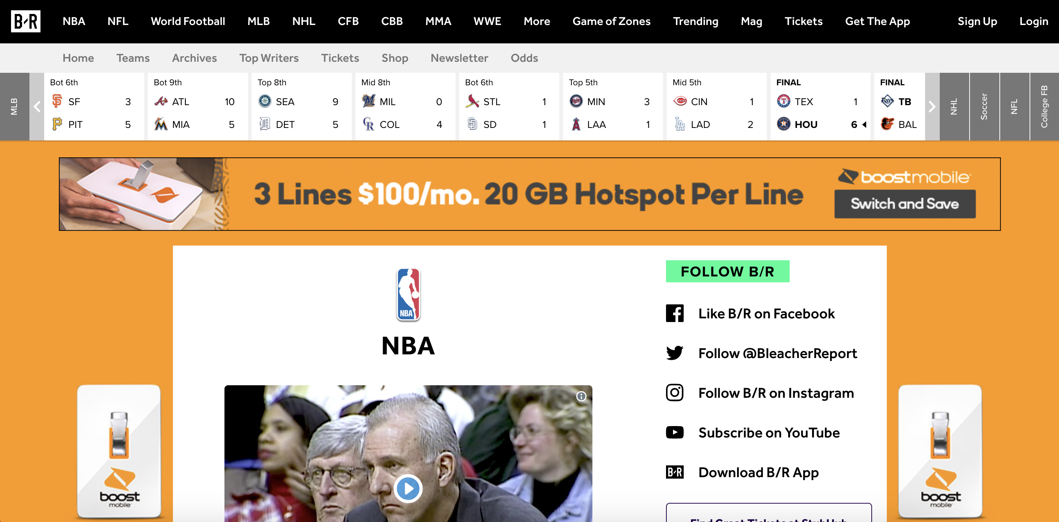
Our Goal: Cluster Articles to Help Build Recommender System for Bleacher Report
Notes:
Bleacher Report is an Online Sports Journal that covers a variety of sports leagues around the world. It has particularly strong coverage of the National Basketball Association. We both enjoy reading its articles.
We think that Bleacher Report could benefit from a recommender system, to provide it with an edge over its online competitors.

Slide 4
Our Goal: Cluster Articles to Help Build Recommender System for Bleacher Report
You Might Like This Article …
Notes:
Bleacher Report is an Online Sports Journal that covers a variety of sports leagues around the world. It has particularly strong coverage of the National Basketball Association. We both enjoy reading its articles.
We think that Bleacher Report could benefit from a recommender system, to provide it with an edge over its online competitors.

Slide 5
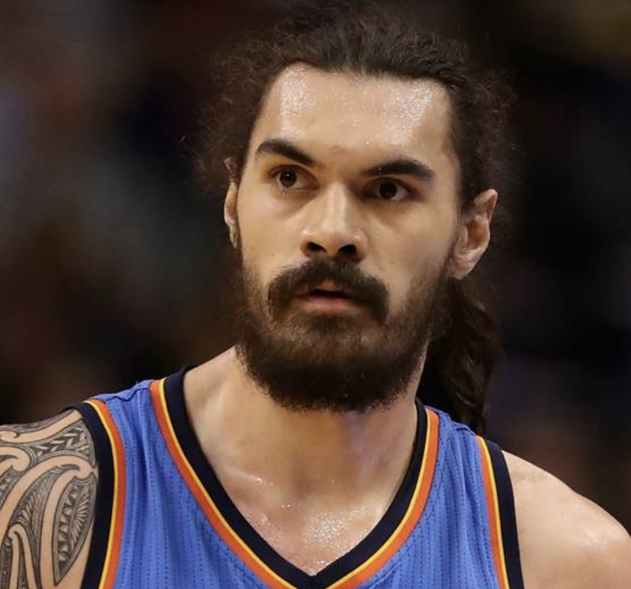
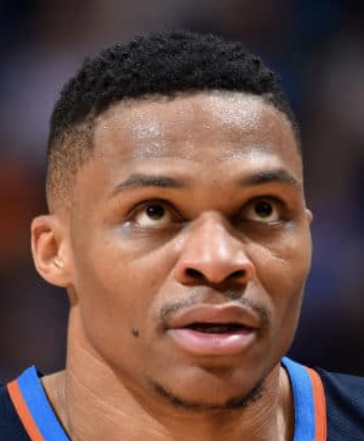
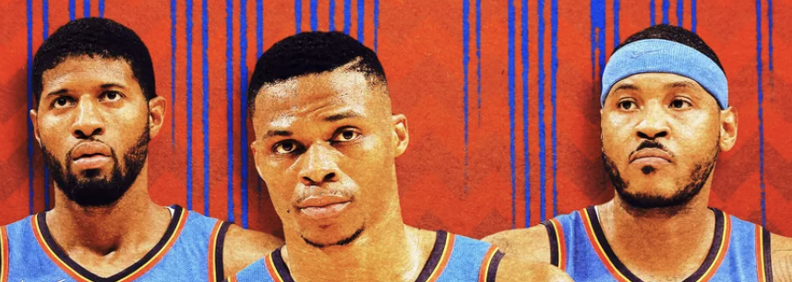
Our Goal: Cluster Articles to Help Build Recommender System for Bleacher Report
Notes:
Bleacher Report is an Online Sports Journal that covers a variety of sports leagues around the world. It has particularly strong coverage of the National Basketball Association. We both enjoy reading its articles.
We think that Bleacher Report could benefit from a recommender system, to provide it with an edge over its online competitors.

Slide 6
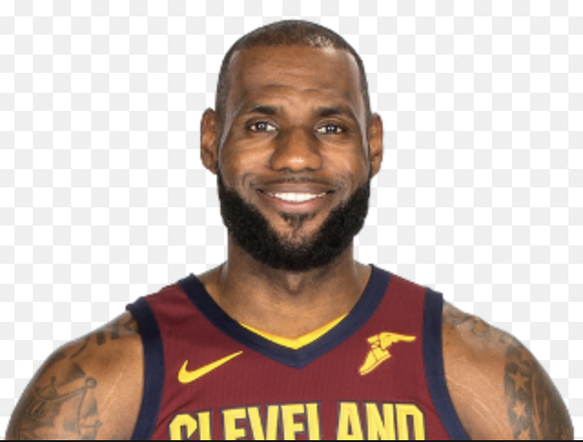

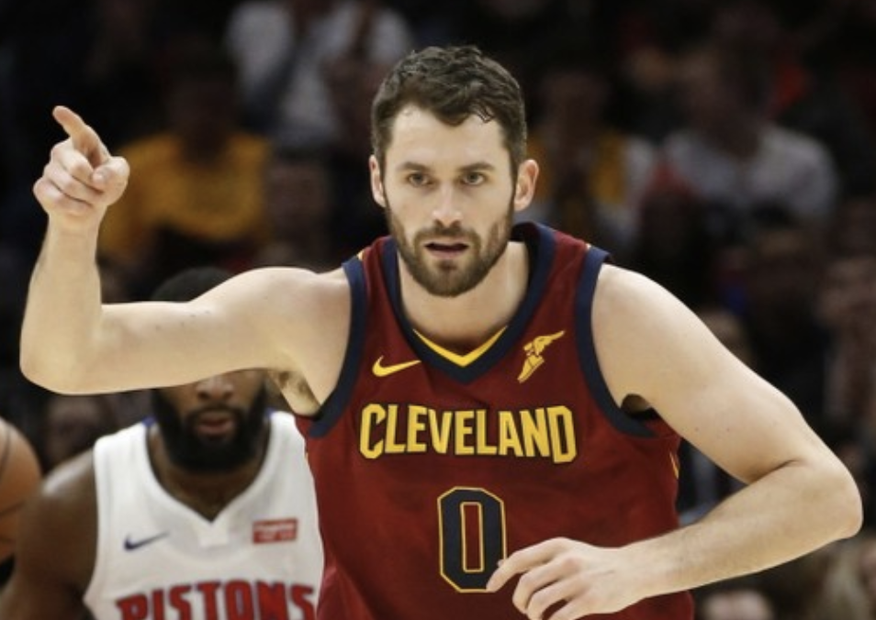
Our Goal: Cluster Articles to Help Build Recommender System for Bleacher Report
Notes:
Bleacher Report is an Online Sports Journal that covers a variety of sports leagues around the world. It has particularly strong coverage of the National Basketball Association. We both enjoy reading its articles.
We think that Bleacher Report could benefit from a recommender system, to provide it with an edge over its online competitors.

Slide 7
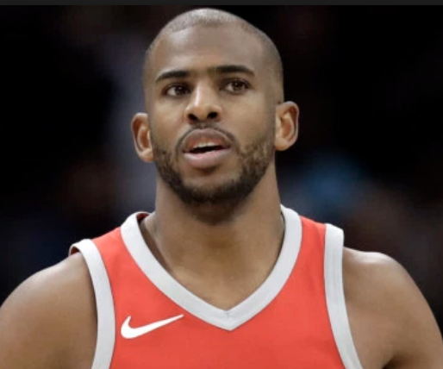

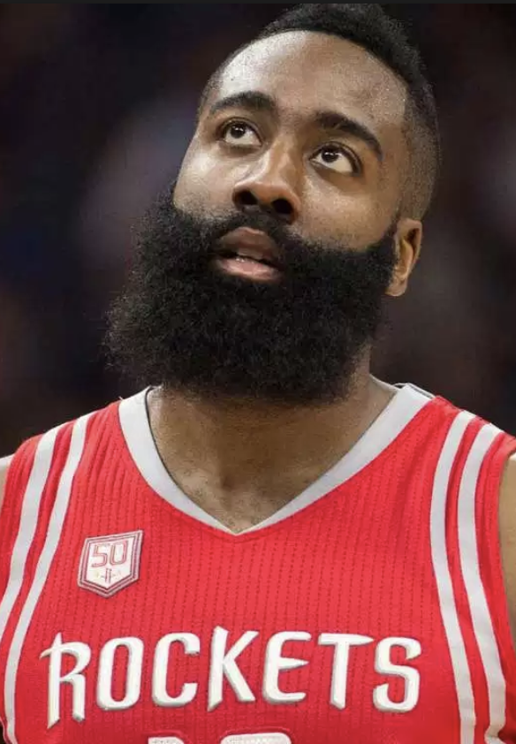
Our Goal: Cluster Articles to Help Build Recommender System for Bleacher Report
Notes:
Bleacher Report is an Online Sports Journal that covers a variety of sports leagues around the world. It has particularly strong coverage of the National Basketball Association. We both enjoy reading its articles.
We think that Bleacher Report could benefit from a recommender system, to provide it with an edge over its online competitors.

Slide 8

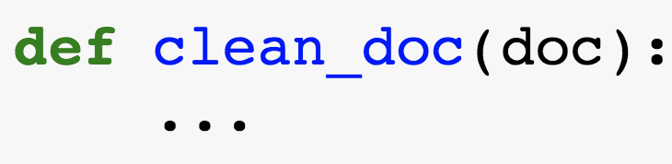
We Scraped & Cleaned 3000 Articles From bleacherreport.com
Article URLs
Python Web Scraper
Text Cleaning using NLP
Clean Documents Ready for Analysis

Slide 9
We Scraped & Cleaned 3000 Articles From bleacherreport.com
Cleaning Steps
Notes:
Once we scraped the articles, we needed to clean them. This involved punctuation and stop word (very basic word) removal, and lowercasing. It also required a special kind of tokenization for our task, which we refer to as “NBA tokenization”. We basically convert players, teams, and coaches names to underscored formal full names, so that every appearance of Lebron, Bron, Lebron James, etc. will be represented as lebron_james. Lastly, we trimmed the vocabulary to ignore words that are too infrequent (e.g. only occurring once) or too common (e.g. play, run, say, go) but not considered stop words.

Slide 10
We Scraped & Cleaned 3000 Articles From bleacherreport.com
Cleaning Steps
Punctuation and Stop Word Removal
The all-star game at 8 p.m. will include Steph Curry, and Lebron; it will be a bunch of fun!
-> all-star game include Steph Curry Lebron bunch fun
Notes:
Once we scraped the articles, we needed to clean them. This involved punctuation and stop word (very basic word) removal, and lowercasing. It also required a special kind of tokenization for our task, which we refer to as “NBA tokenization”. We basically convert players, teams, and coaches names to underscored formal full names, so that every appearance of Lebron, Bron, Lebron James, etc. will be represented as lebron_james. Lastly, we trimmed the vocabulary to ignore words that are too infrequent (e.g. only occurring once) or too common (e.g. play, run, say, go) but not considered stop words.

Slide 11
We Scraped & Cleaned 3000 Articles From bleacherreport.com
Cleaning Steps
Punctuation and Stop Word Removal
The all-star game at 8 p.m. will include Steph Curry, and Lebron; it will be a bunch of fun!
-> all-star game include Steph Curry Lebron bunch fun
2. Lowercasing
all-star game include steph curry lebron bunch fun
Notes:
Once we scraped the articles, we needed to clean them. This involved punctuation and stop word (very basic word) removal, and lowercasing. It also required a special kind of tokenization for our task, which we refer to as “NBA tokenization”. We basically convert players, teams, and coaches names to underscored formal full names, so that every appearance of Lebron, Bron, Lebron James, etc. will be represented as lebron_james. Lastly, we trimmed the vocabulary to ignore words that are too infrequent (e.g. only occurring once) or too common (e.g. play, run, say, go) but not considered stop words.

Slide 12
We Scraped & Cleaned 3000 Articles From bleacherreport.com
Cleaning Steps
Punctuation and Stop Word Removal
The all-star game at 8 p.m. will include Steph Curry, and Lebron; it will be a bunch of fun!
-> all-star game include Steph Curry Lebron bunch fun
2. Lowercasing
all-star game include steph curry lebron bunch fun
3. NBA Tokenization
-> all-star game include stephen_curry lebron_james bunch fun
Notes:
Once we scraped the articles, we needed to clean them. This involved punctuation and stop word (very basic word) removal, and lowercasing. It also required a special kind of tokenization for our task, which we refer to as “NBA tokenization”. We basically convert players, teams, and coaches names to underscored formal full names, so that every appearance of Lebron, Bron, Lebron James, etc. will be represented as lebron_james. Lastly, we trimmed the vocabulary to ignore words that are too infrequent (e.g. only occurring once) or too common (e.g. play, run, say, go) but not considered stop words.

Slide 13
We Scraped & Cleaned 3000 Articles From bleacherreport.com
Cleaning Steps
Punctuation and Stop Word Removal
The all-star game at 8 p.m. will include Steph Curry, and Lebron; it will be a bunch of fun!
-> all-star game include Steph Curry Lebron bunch fun
2. Lowercasing
all-star game include steph curry lebron bunch fun
3. NBA Tokenization
-> all-star game include stephen_curry lebron_james bunch fun
4. Trim Vocabulary using Document Frequency: remove words that are too infrequent and too common
Notes:
Once we scraped the articles, we needed to clean them. This involved punctuation and stop word (very basic word) removal, and lowercasing. It also required a special kind of tokenization for our task, which we refer to as “NBA tokenization”. We basically convert players, teams, and coaches names to underscored formal full names, so that every appearance of Lebron, Bron, Lebron James, etc. will be represented as lebron_james. Lastly, we trimmed the vocabulary to ignore words that are too infrequent (e.g. only occurring once) or too common (e.g. play, run, say, go) but not considered stop words.

Slide 14
We Want to Use Topic Modeling to Find Underlying Topics in the Articles
Topic: A probability distribution over all words in the vocabulary

Slide 15
We Want to Use Topic Modeling to Find Underlying Topics in the Articles
Topic: A probability distribution over all words in the vocabulary
Topic Model assumes each document ”written” as follows:
For each word in document:
1. pick topic at random
2. pick word from that topic’s distribution
3. write that word

Slide 16
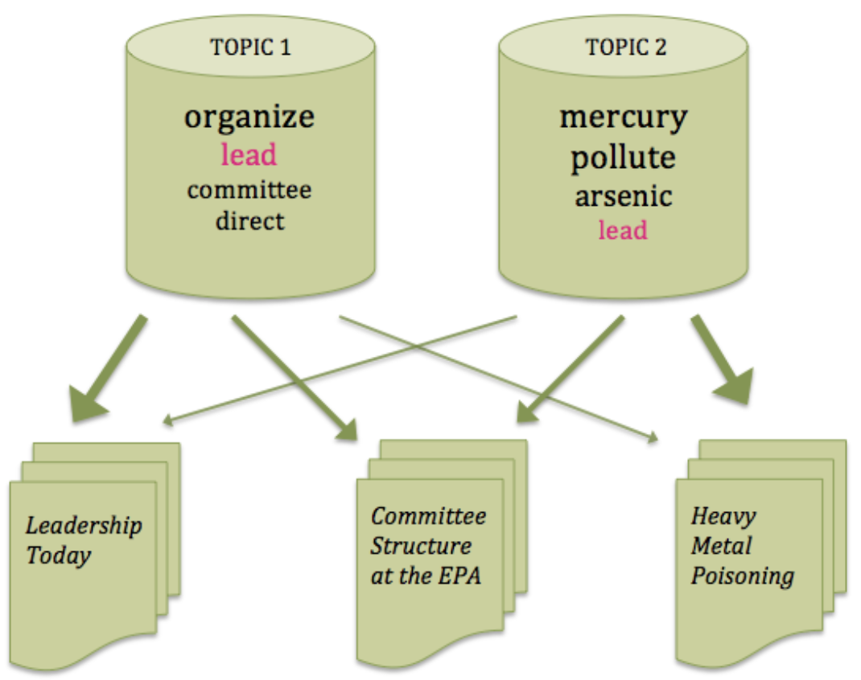
We Want to Use Topic Modeling to Find Underlying Topics in the Articles
Topic: A probability distribution over all words in the vocabulary
Topic Model assumes each document ”written” as follows:
For each word in document:
1. pick topic at random
2. pick word from that topic’s distribution
3. write that word

Slide 17
We Want to Use Topic Modeling to Find Underlying Topics in the Articles
Topic: A probability distribution over all words in the vocabulary
Topic Model assumes each document ”written” as follows:
For each word in document:
1. pick topic at random
2. pick word from that topic’s distribution
3. write that word
Goal:
1. Find the topics distributions that best explain the data we observe (we specify num_topics up front)
2. Express each article as a mixture (vector) of multiple topics.
3. Use those mixture vectors to cluster the articles by their topic composition.

Slide 18
We Want to Use Topic Modeling to Find Underlying Topics in the Articles
Topic: A probability distribution over all words in the vocabulary
Topic Model assumes each document ”written” as follows:
For each word in document:
1. pick topic at random
2. pick word from that topic’s distribution
3. write that word
Goal:
1. Find the topics distributions that best explain the data we observe (we specify num_topics up front)
2. Express each article as a mixture (vector) of multiple topics.
3. Use those mixture vectors to cluster the articles by their topic composition.

Slide 19
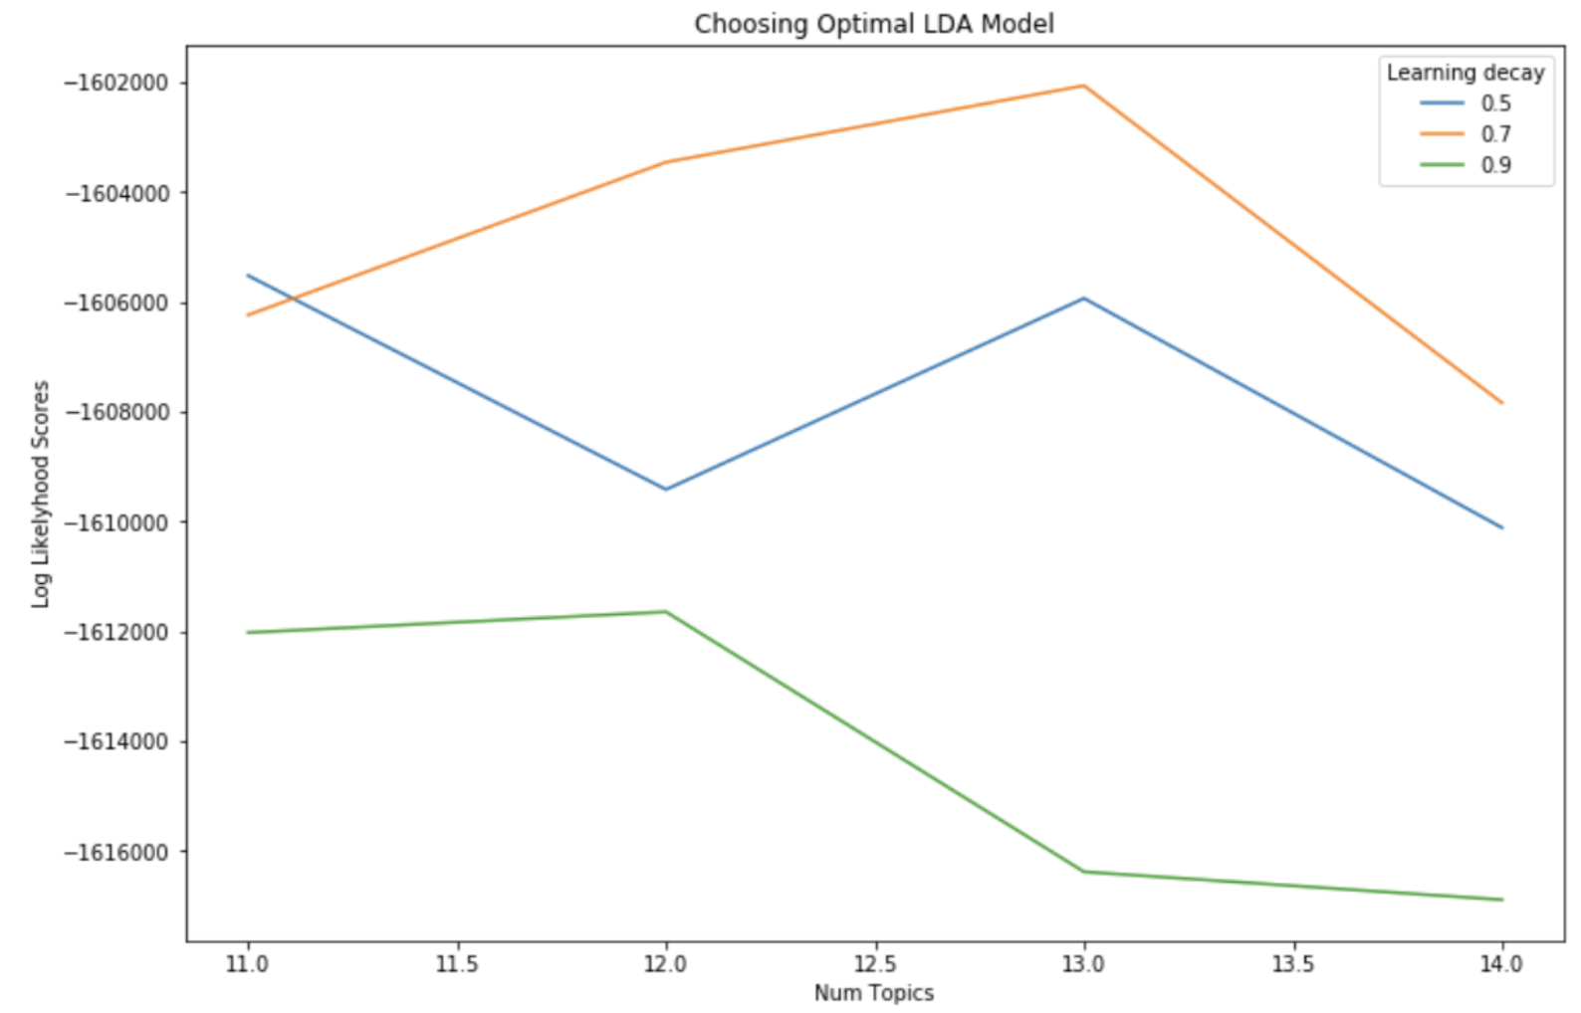
We Used Likelihood to Fine-Tune Hyperparameters, Including Number of Topics
Notes:
We used Grid Search to fine-tune two hyperparameters – number of topics to look for and something called learning decay. Let’s just focus on the number of topic for now. We performed search over a large range, and then narrowed down the search. Here we show the narrowed search over the range [10,14] for number of topics. As you can see the best number of topics was 13.

Slide 20
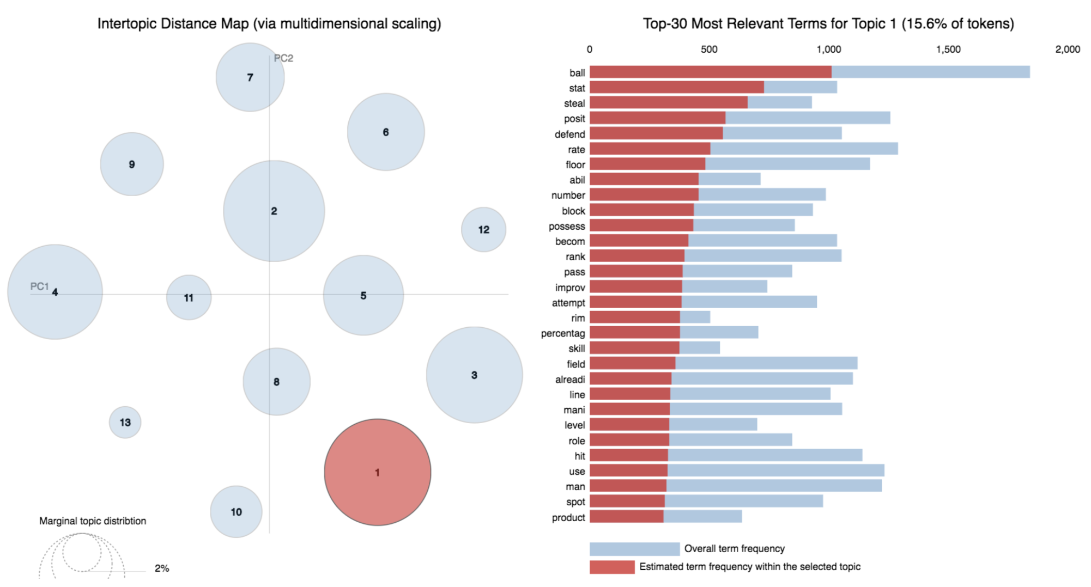
Topic 1: The Statistics of Basketball
Notes:
We then produced visualizations over our topic model in Python. The blue circles represent the topics. The size of the circle is proportional to the proportions of topics across the documents. The positions of the circles is meant to be a 2D projection of their locations with respect to each other in topic space.
The red bars indicate the estimated number of times a given term came from a given topic. When you hover over a topic, the most relevant terms to that topic are shown. We can see that topic 1 is all about the statistics of basketball. The primary terms of stat, steal, defend, rate, blocks, percentage, etc.

Slide 21
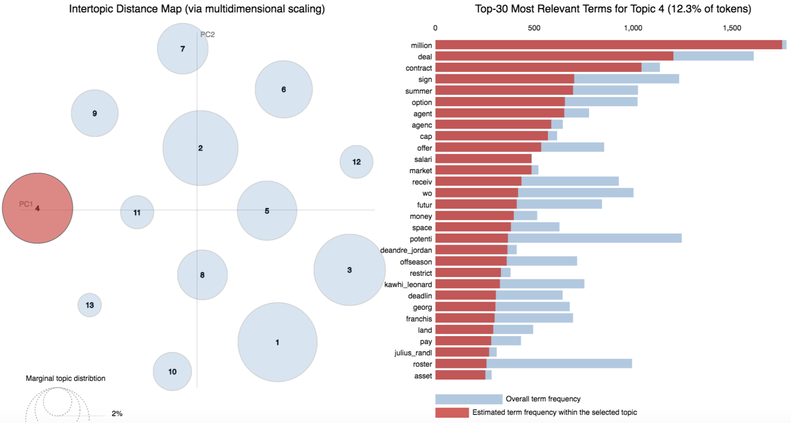
Topic 4: The Economics of Basketball
Notes:
Topic 4 is all about the economics of basketball. The primary terms of million, deal, contract, sign, summer, option, agent, etc…Articles with this topic are probably about free agency or trades in some way.

Slide 22
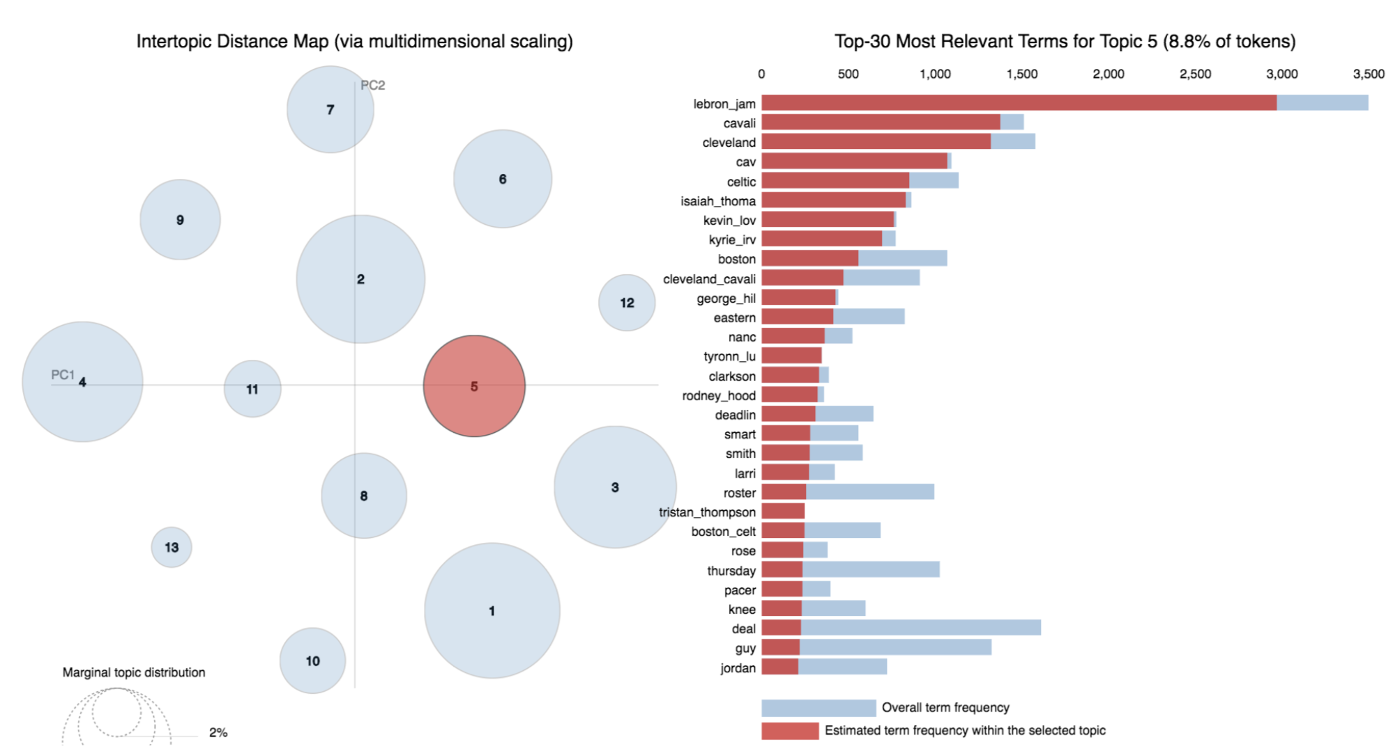
Topic 5: The King of Basketball
Notes:
Lebron James is so popular, he has his own topic! All the names are either his team mates or his coaches.

Slide 23
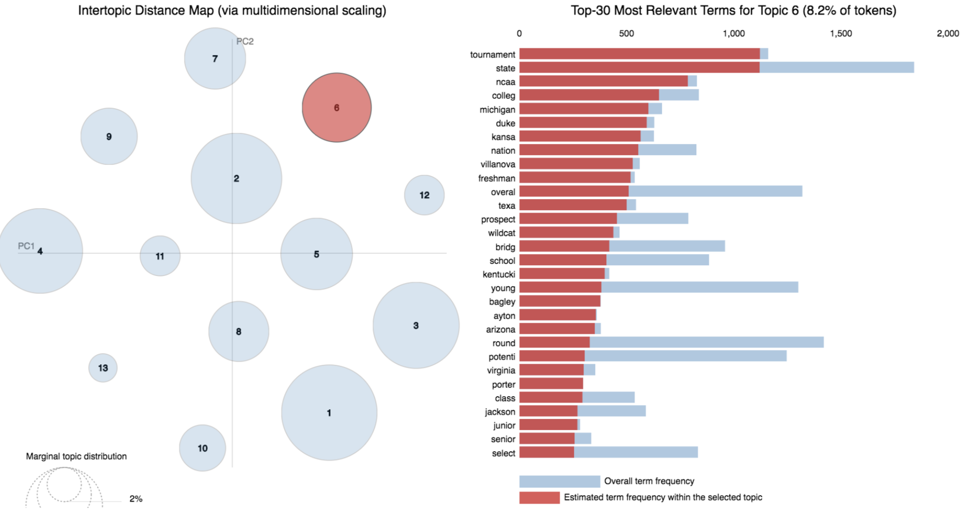
Topic 6: March Madness College Basketball
Notes:
Every year around March, the NBA stops getting attention and news articles turn toward the big NCAA “March Madness” tournament. Michgan played Villanova for the championship game. Duke, Kansas, and Texas were among other leading teams this year.

Slide 24
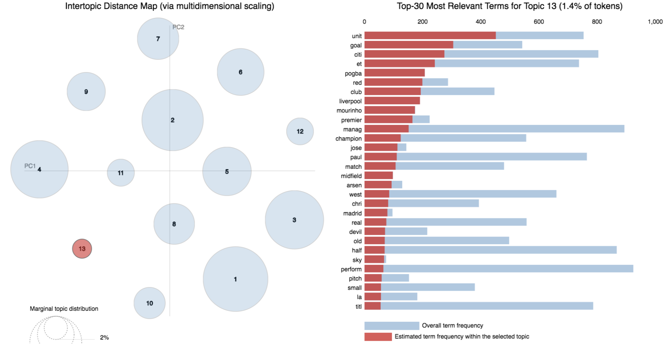
Topic 13: Some Soccer Articles Snuck In Somehow …
Notes:
When we queried for NBA article URLs, the API we used (NewsAPI) must have returned several soccer articles as well. Quite interesting that they showed up as their own cluster.
Other topics are left out of this presentation for brevity. They are usually about specific teams or events, or about the playoffs in general. There are a couple that don’t stand out as being about a unifying theme.

Slide 25
Thank You! Any Questions?
Project Motivation and Goal
2. Data Collection and Cleaning
3. Topic Modeling with LDA
4. Visualizations
Notes:
Today we will walk through the motivation for our project, including what we see as its ultimate goal. Then we will talk about the data gathering and cleaning process. Then we will deep dive into our topic modeling work, and finish with some visualizations of our results.

